Slide 1

CRO-659(R) Maintenance, Inspection/Testing & Repair of Freight and Passenger Elevators at Multiple DEP Facilities
NYC Environmental Protection, Bureau of Water Supply
Pre-Bid Conference/Site Visit
Date: March 19, 2026
Time: 10:00 AM
Location: Croton Filtration Plant
3701 Jerome Avenue, Bronx, NY 10467
Via Teams Meeting Call-in: +1 585-484-8792,
Conference ID: 874 444 640#

Slide 2
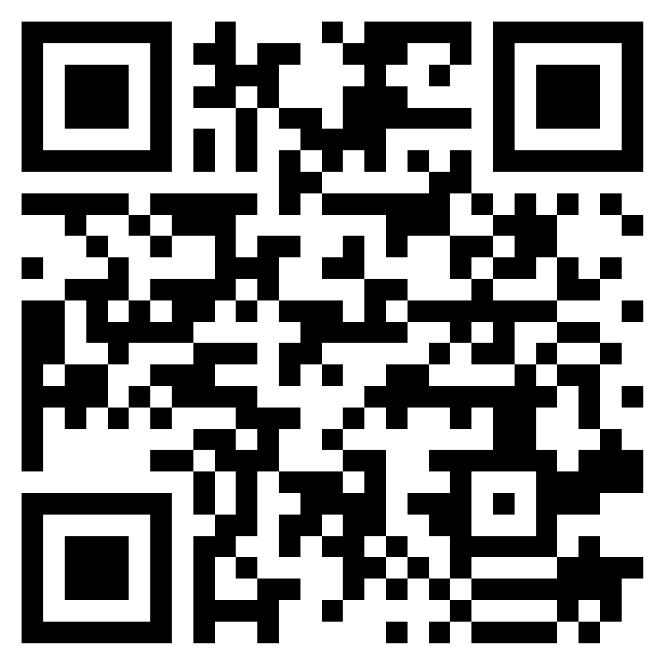
Scan the QR Code
After Scanning, Enter all requested information, the completed list will be posted in PASSPort
Contract Number CRO-659(R)

Slide 3
Agenda
Introductions / Attendance
Contract Summary/Scope of Work
Health and Safety Requirements
Diversity
Local Law 1: NYC M/WBE Program
Subcontractor Approval
Prevailing Wage
PASSPort Guidelines
Registration with State Department of Labor
General Contract Requirements
Bid Protocol/Key Dates
Questions

Slide 4
NOTIFICATION
BE ADVISED THAT THE INFORMATION IN THIS PRE-BID CONFERENCE DOES NOT SUPERSEDE ANY INFORMATION IN THE ORIGINAL INVITATION FOR BID IN PASSPORT.
ANY ITEMS THAT A VENDOR NEEDS CLARIFICATION ON SHOULD BE SUBMITTED AS A QUESTION IN THE DISCUSSION FORUM IN PASSPORT.

Slide 5
Contract Summary/Scope of Work
LIST OF WORK LOCATIONS
FACILITY | LOCATION ADDRESS
Croton Filtration Plant (CFP) | 3701 Jerome Avenue, Bronx, NY 10467
*Please note the Croton Filtration Plant facility is underground. All equipment to be serviced is underground.
Facility Locations in Westchester County:
FACILITY | LOCATION ADDRESS
Catskill/Delaware Ultraviolet Disinfection Plant (CDUV) | 10 Walker Road, Valhalla, NY 10595
DEP Police 6th Precinct (Eastview) | 2 Walker Road, Valhalla, NY 10595
Delaware Aqueduct Shaft 17 (Shaft 17) | 10 Cooney Hill Road, Armonk, NY 10504
Croton Lake Gatehouse (CLGH) | 1120 Croton Dam Road, Yorktown Heights, NY 10598

Slide 6
Contract Summary/Scope of Work
The Work under this Contract is for Preventive Maintenance, Inspection/Testing, and Repairs of Freight & Passenger Elevators at multiple DEP Facilities in the Bronx and Westchester County.
​
The following categories of Work are included under this Contract:
​
  Preventive Maintenance​
        Monthly, Quarterly, Semi-Annually, Annually Preventive Maintenance
  Inspections and Testing​
        Annual Inspection/Testing Category 1(CAT 1) for All Elevators
        Once every Five-year Inspection/Testing Category 5 (CAT 5) for All Elevators
        Replace and Test Safety Device for Rack-and-Pinion Elevator
  Repair Work​
        Field Repair​
        Shop Repair​

Slide 7
Contract Summary/Scope of Work
  Section 2.1 of the Detailed Specifications covers from Maintenance, Inspection/Testing, and repairs.
  Exhibit G describes in detail each Preventive Maintenance, and Inspection/Testing item for the detailed scope as well as the scheduling for this 3-year contract term.
  -Preventive Maintenance, Inspections and Testing Work will be issued in the form of Work Orders in CMMS.
  -Payment for Preventive Maintenance and Inspection/Testing will be based on the unit prices as identified in the Price Sheet, Section 2.15 (Payment) and Exhibit G. The Contractor shall provide all labor, parts, materials and equipment necessary to complete the Work in accordance with these Specifications, including but not limited to labor, parts, materials and equipment necessary for applying and removing its own lock to follow DEP LOTO procedures.

Slide 8
Contract Summary/Scope of Work
Preventive Maintenance Schedule and Inspection/Testing
Equipment Number (From Exhibit A) |  | 1 | 2 | 3 | 4 | 5 | 6 | 7 | 8 | 9 | 10
Site Location |  | CDUV | 6th PCT | CFP |  |  |  |  | CLGH |  | SH17
Elevator Type |  | Hydraulic | Hydraulic | Electrical Traction |  |  | Hydraulic |  | Electrical Traction | Hydraulic | Rack-and-Pinion
Preventive Maintenance Schedule – Typical Cycle of Maintenance for Each Elevator | Month 1 | M | M | \ | \ | \ | \ | \ | \ | \ | \
 | Month 2 | M | M | \ | \ | \ | \ | \ | \ | \ | \
 | Month 3 | M | M | Q | Q | Q | Q | Q | Q | Q | Q
 | Month 4 | M | M | \ | \ | \ | \ | \ | \ | \ | \
 | Month 5 | M | M | \ | \ | \ | \ | \ | \ | \ | \
 | Month 6 | M | M | SA | SA | SA | SA | SA | SA | SA | SA
 | Month 7 | M | M | \ | \ | \ | \ | \ | \ | \ | \
 | Month 8 | M | M | \ | \ | \ | \ | \ | \ | \ | \
 | Month 9 | M | M | Q | Q | Q | Q | Q | Q | Q | Q
 | Month 10 | M | M | \ | \ | \ | \ | \ | \ | \ | \
 | Month 11 | M | M | \ | \ | \ | \ | \ | \ | \ | \
 | Month 12 | A | A | A | A | A | A | A | A | A | A
Inspection/Testing Category 1 (CAT 1) Category 5 (CAT 5) |  | Required | Required | Required | Required | Required | Required | Required | Required | Required | Required
Replace & Test Safety Device Including Full-Load Drop Test |  | \ | \ | \ | \ | \ | \ | \ | \ | \ | Required
M – Monthly Preventive Maintenance Q – Quarterly Preventive Maintenance SA – Semi-Annual Preventive Maintenance A – Annual Preventive Maintenance

Slide 9
Contract Summary/Scope of Work
The Contractor shall conduct preventive maintenance for the Elevators according to the schedule as described in the table in Exhibit G or as directed by the DEP Project Manager. The previous table shows a typical cycle of preventive maintenance for each elevator. The Contractor shall review the elevator service history and confirm with DEP Project Manager to determine which preventive maintenance task should be performed.
Prior to any site arrival for the work orders scheduled by DEP Project Manager, the Contractor shall prepare Safe Work Plan (SWP) and Job Hazard Analysis (JHA) for DEP Project Manager’s and EH&S representative’s Review and Approval.

Slide 10
Contract Summary/Scope of Work
  The Contractor shall report all findings of Maintenance, Inspections and Testing Work at the end of each day to the Project Manager.
  If the Contractor determines that repair Work is necessary beyond the scope of the Inspections and Testing Work, they shall submit a repair work request along with the repair plan, cost estimate, and schedule for approval by the Project Manager, in accordance with Section 2.3 Work Order Procedure.

Slide 11
Contract Summary/Scope of Work
  Working Hours
  The Contractor shall perform Work during normal facility operating hours of 7:00 AM to 3:00 PM on Mondays through Fridays, exclusive of holidays (“Regular Hours”).
  Holidays include: New Year’s Day, Martin Luther King Jr. Day, Presidents Day, Memorial Day, Independence Day, Labor Day, Columbus Day, Veteran’s Day, Thanksgiving Day and Christmas Day.
  “Off Hours” are defined as weekends, the holidays listed above and 3:00 PM to 7:00 AM on Mondays through Fridays.
  The Contractor must receive written approval from the Project Manager before performing Work during Off Hours.

Slide 12
Contract Summary/Scope of Work
  Please Note:
  Exhibit A – List of Equipment of the CRO-659 Specifications indicates Item No. 3 Passenger Elevator 1 at the Croton Filtration Plant services 3 landings. However, it should have indicated 4 landings.
  The following equipment list references the correct information for Item No. 3.
  An addendum will be uploaded in PASSPort to provide a corrected Exhibit A – List of Equipment.

Slide 13
Contract Summary/Scope of Work
List of Equipment
Item No. | Equipment Type | QTY | Manufacturer Elevator No. | General Information | Suppliers​
1 | Passenger Elevator Type: Hydraulic Location: (CDUV) Catskill/Delaware Ultraviolet Disinfection Plant, 10 Walker Road, Valhalla, NY | 1 | SEW Construction | Capacity: 5,000 lb No. of landing: 2 Speed: 100 FPM Travel: 20 Ft Doors: 1 front opening Power: 480V/3Ph/60 Hz | Elevator: OTIS
2 | Passenger Elevator Type: Hydraulic Location: DEP Police 6th Precinct (Eastview), 2 Walker Road, Valhalla, NY | 1 | SEW Construction | Capacity: 2,500 lb No. of landing: 3 Speed: 100 FPM Travel: 28 Ft Doors: 1 front opening Power: 480V/3Ph/60 Hz | Elevator: OTIS
3 | Passenger Elevator Tag: PE-1 Type: Electrical Traction Location: Croton Filtration Plant (CFP)-NE corner, 3701 Jerome Avenue, Bronx, NY | 1 | Height Elevator Corp 914-962-4860 Elevator No. 2P11367 | Capacity: 2,500 lb No. of landing: 4 Speed: 200 FPM Travel: 72 Ft Doors: 1 front opening Power: 480V/3Ph/60 Hz | Elevator: Hollister Whitney Cab: EDI /ECI Door Operator : GAL Manufacturer Corp Control: Elevator Controls Corp Signal Equip: PTL Equipment

Slide 14
Contract Summary/Scope of Work
Item No. | Equipment Type | QTY | Manufacturer Elevator No. | General Information | Suppliers​
4 | Passenger Elevator Tag: PE-2 Type: Electrical Traction Location: Croton Filtration Plant (CFP)-SE corner, 3701 Jerome Avenue, Bronx, NY | 1 | Height Elevator Corp 914-962-4860 Elevator No. 2P11368 | Capacity: 3,500 lb No. of landing: 3 Speed: 200 FPM Travel: 48 Ft Doors: 1 front opening Power: 480V/3Ph/60 Hz | Elevator: Hollister Whitney Cab: EDI /ECI Door Operator : GAL Manufacturer Corp Control: Elevator Controls Corp Signal Equip: PTL Equipment
5 | Passenger Elevator Tag: PE-3 Type: Electrical Traction Location: Croton Filtration Plant (CFP)-SW corner, 3701 Jerome Avenue, Bronx, NY | 1 | Height Elevator Corp 914-962-4860 Elevator No. 2P11369 | Capacity: 3,500 lb No. of landing: 3 Speed: 200 FPM Travel: 48 Ft Doors: 1 front opening Power: 480V/3Ph/60 Hz | Elevator: Hollister Whitney Cab: EDI /ECI Door Operator : GAL Manufacturer Corp Control: Elevator Controls Corp Signal Equip: PTL Equipment
6 | Freight Elevator Tag: FE-1 Type: Hydraulic Location: Croton Filtration Plant (CFP)-NE corner, 3701 Jerome Avenue, Bronx, NY | 1 | Height Elevator Corp 914-962-4860 Elevator No. 2F6050 | Capacity: 16,000 lb No. of landing: 4 Speed: 90 FPM Travel: 72 Ft Doors: 1 Powered vertical bi-parting Power: 480V/3Ph/60 Hz | Elevator: Cemco Lift Elevator Systems Cab: Courion Doors Inc. Signal Equip: PTL Equipment Control: Elevator Controls Corp Have Exxon NUTO h32 oil approx. 450 gallons

Slide 15
Contract Summary/Scope of Work
Item No. | Equipment Type | QTY | Manufacturer Elevator No. | General Information | Suppliers​
7 | Freight Elevator Tag: FE-2 Type: Hydraulic Location: Croton Filtration Plant (CFP)-NW corner, 3701 Jerome Avenue, Bronx, NY | 1 | Height Elevator Corp 914-962-4860 Elevator No. 2F6051 | Capacity: 16,000 lb No. of landing: 4 Speed: 90 FPM Travel: 48 Ft Doors: 1 Powered vertical bi-parting Power: 480V/3Ph/60Hz | Elevator: Cemco Lift Elevator Systems Cab: Courion Doors Inc. Signal Equip: PTL Equipment Have Exxon NUTO h32 oil approx. 450 gallons. Elevator Controls Corp
8 | Freight Elevator Type: Electrical Traction Location: (CLGH) Croton Lake Gatehouse 1120 Croton Dam Road Yorktown Heights, NY | 1 | N/A | Capacity: 20,000 lb No. of landing: 5 Speed: 150 FPM Travel: 85 Ft Doors: 2 - Front and Rear openings Power: 480V/3Ph/60 Hz | Elevator: Hollister Whitney Door Operator: Peele Control: MCE
9 | Passenger Elevator Type: Hydraulic Location: (CLGH) Croton Lake Gatehouse 1120 Croton Dam Road Yorktown Heights, NY | 1 | N/A | Capacity: 2,500 lb No. of landing: 2 Speed: 100 FPM Travel: 19 Ft Doors: 1 front opening Power: 480V/3Ph/60 Hz | Elevator: Payton Control: Virginia

Slide 16
Contract Summary/Scope of Work
Item No. | Equipment Type | QTY | Manufacturer Elevator No. | General Information | Suppliers​
10 | Freight Elevator Type: Rack and Pinion Location: Delaware Aqueduct Shaft 17 10 Cooney Hill Road Armonk, NY | 1 | Height Elevator Corp | Capacity: 3,500 lb No. of landing: 4 Speed: 125 FPM Travel: 39 Ft Doors: 1 front opening Power: 480V/3Ph/60 Hz | Elevator: PEGA Hoist Ltd. (Czech Republic)

Slide 17
Contract Summary/Scope of Work
Equipment Service History
Item No. | Equipment Type | QTY | Last Service Performed
1 | Passenger Elevator Type: Hydraulic Location: (CDUV) Catskill/Delaware Ultraviolet Disinfection Plant, 10 Walker Road, Valhalla, NY | 1 | 06/2025 Monthly Preventive Maintenance 06/2025 CAT-1
2 | Passenger Elevator Type: Hydraulic Location: DEP Police 6th Precinct (Eastview), 2 Walker Road, Valhalla, NY | 1 | 06/2025 Monthly Preventive Maintenance 06/2025 CAT-1
3 | Passenger Elevator Tag: PE-1 Type: Electrical Traction Location: Croton Filtration Plant (CFP)-NE corner, 3701 Jerome Avenue, Bronx, NY | 1 | 12/2024 Annual, Semi-annual & Quarterly Preventive Maintenance 03/2025 Quarterly Preventive Maintenance 12/2024 CAT-1
4 | Passenger Elevator Tag: PE-2 Type: Electrical Traction Location: Croton Filtration Plant (CFP)-SE corner, 3701 Jerome Avenue, Bronx, NY | 1 | 12/2024 Annual, Semi-annual & Quarterly Preventive Maintenance 03/2025 Quarterly Preventive Maintenance 12/2024 CAT-1
5 | Passenger Elevator Tag: PE-3 Type: Electrical Traction Location: Croton Filtration Plant (CFP)-SW corner, 3701 Jerome Avenue, Bronx, NY | 1 | 12/2024 Annual, Semi-annual & Quarterly Preventive Maintenance 12/2024 CAT-1 This Elevator has been out of service since January 2025 due to needed repairs. Repairs will need to be completed to put this Elevator back in service.

Slide 18
Contract Summary/Scope of Work
Item No. | Equipment Type | QTY | Last Service Performed
6 | Freight Elevator Tag: FE-1 Type: Hydraulic Location: Croton Filtration Plant (CFP)-NE corner, 3701 Jerome Avenue, Bronx, NY | 1 | 12/2024 Annual, Semi-annual & Quarterly Preventive Maintenance 03/2025 Quarterly Preventive Maintenance 12/2024 CAT-1
7 | Freight Elevator Tag: FE-2 Type: Hydraulic Location: Croton Filtration Plant (CFP)-NW corner, 3701 Jerome Avenue, Bronx, NY | 1 | 12/2024 Annual, Semi-annual & Quarterly Preventive Maintenance 03/2025 Quarterly Preventive Maintenance 12/2024 CAT-1
8 | Freight Elevator Type: Electrical Traction Location: (CLGH) Croton Lake Gatehouse, 1120 Croton Dam Road, Yorktown Heights, NY | 1 | 01/2025 Annual Semi-annual & Quarterly Preventive Maintenance 06/2025 Semi-annual & Quarterly Preventive Maintenance 03/2024 CAT-1
9 | Passenger Elevator Type: Hydraulic Location: (CLGH) Croton Lake Gatehouse, 1120 Croton Dam Road, Yorktown Heights, NY | 1 | 01/2025 Annual, Semi-annual & Quarterly Preventive Maintenance 06/2025 Semi-annual & Quarterly Preventive Maintenance 03/2024 CAT-1
10 | Freight Elevator Type: Rack and Pinion Location: Delaware Aqueduct Shaft 17, 10 Cooney Hill Road, Armonk, NY | 1 | This Elevator has been out of service for over 10 years and will need to be repaired before being put back into service. DEP does not have any past service history for this elevator.

Slide 19
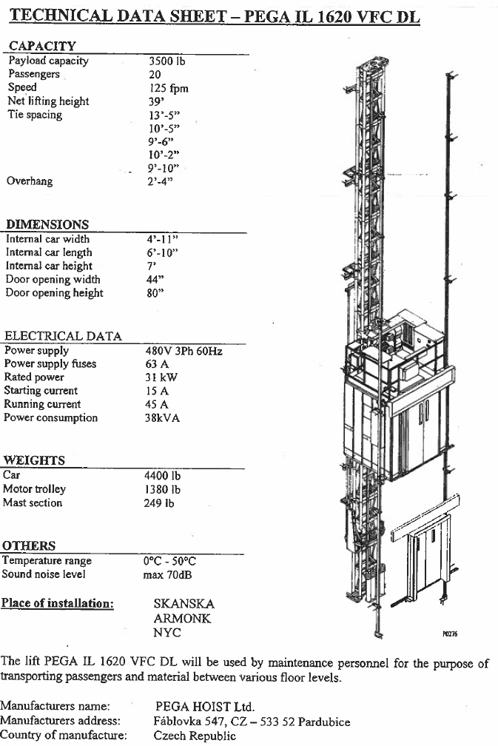



Contract Summary/Scope of Work
Rack-and-Pinion Elevator Service at Delaware Shaft 17
Elevator History
  Out of service for over 10 years.
The Repair Work shall be completed for this elevator prior to any Preventive Maintenance Work, for this elevator, Item No. 10.
  The Contractor shall furnish all necessary labor, parts, materials and equipment for performing Inspection of this elevator. Then the repair estimate and proposal shall be submitted for Project Manager’s approval before any repair work for this elevator.

Slide 20
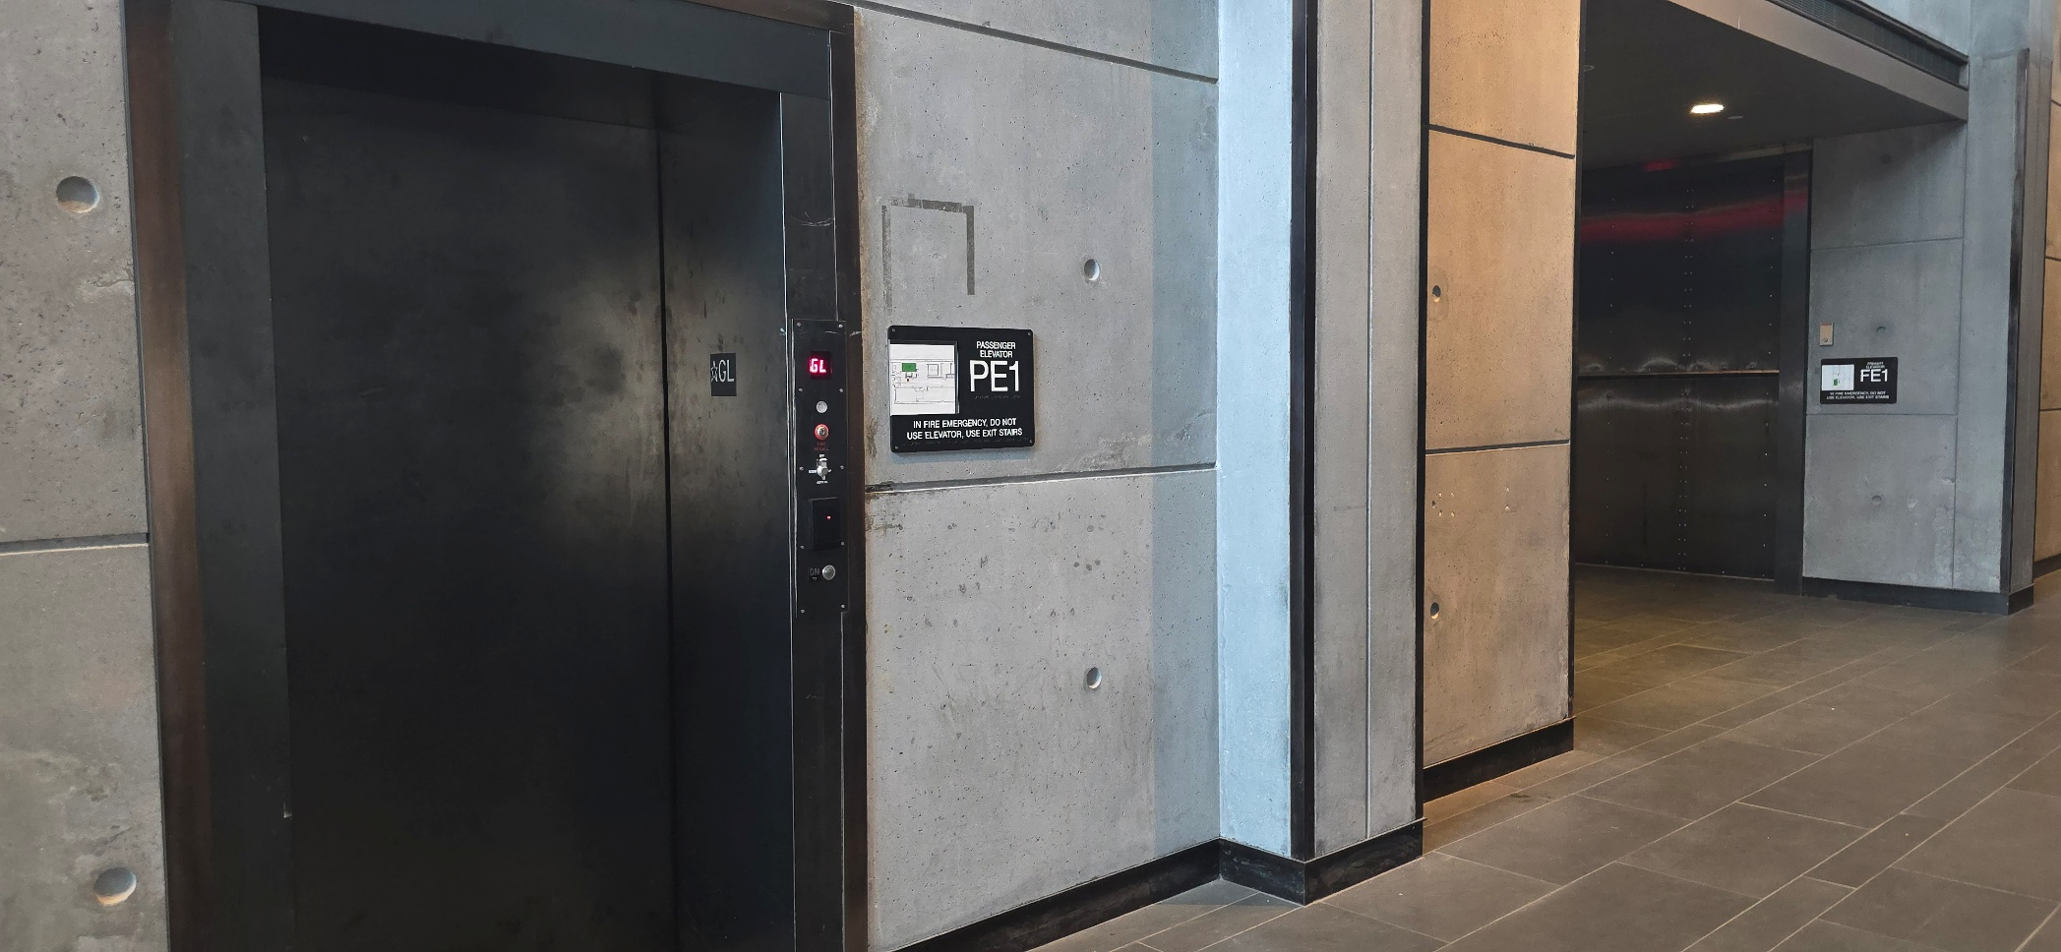
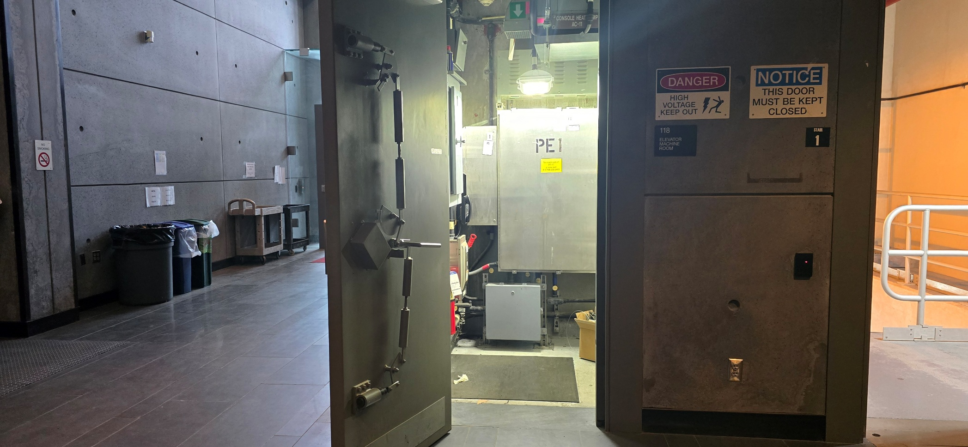
Contract Summary/Scope of Work
Equipment at Croton Filtration Plant
Fig. 1 PE-1 Electrical Traction (Passenger) Elevator
Fig. 2 PE-1 Elevator Machine Room

Slide 21
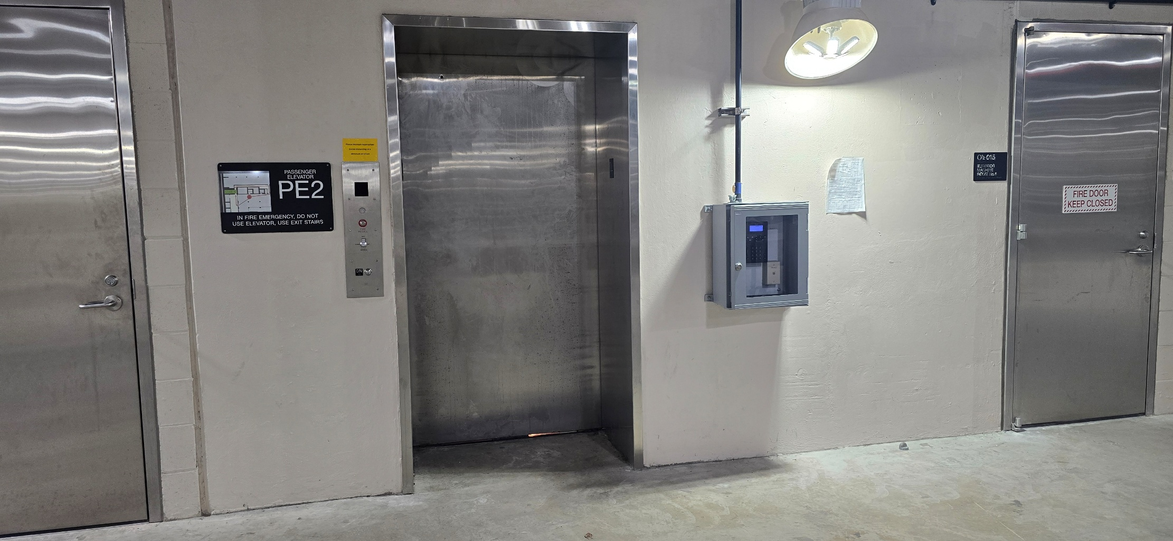
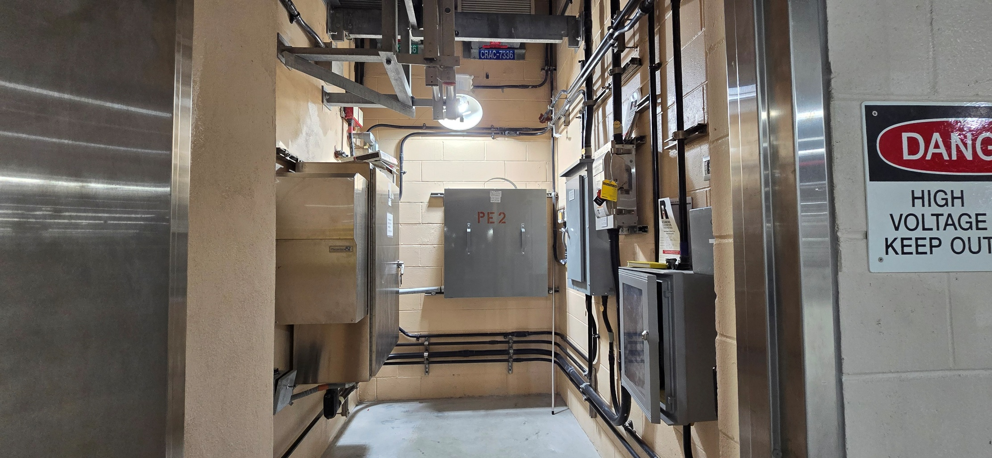
Contract Summary/Scope of Work
Fig. 3 PE-2 Electrical Traction (Passenger) Elevator
Fig. 4 PE-2 Elevator Machine Room

Slide 22
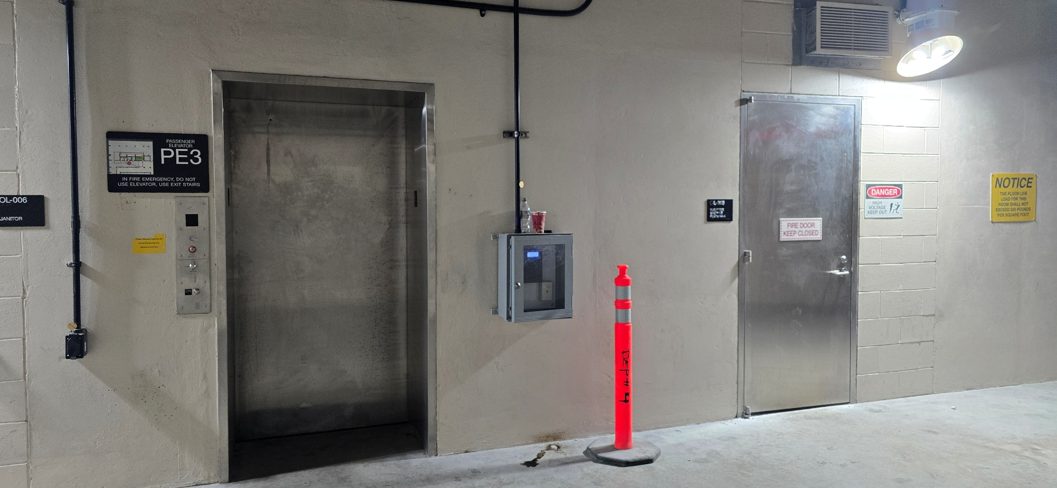
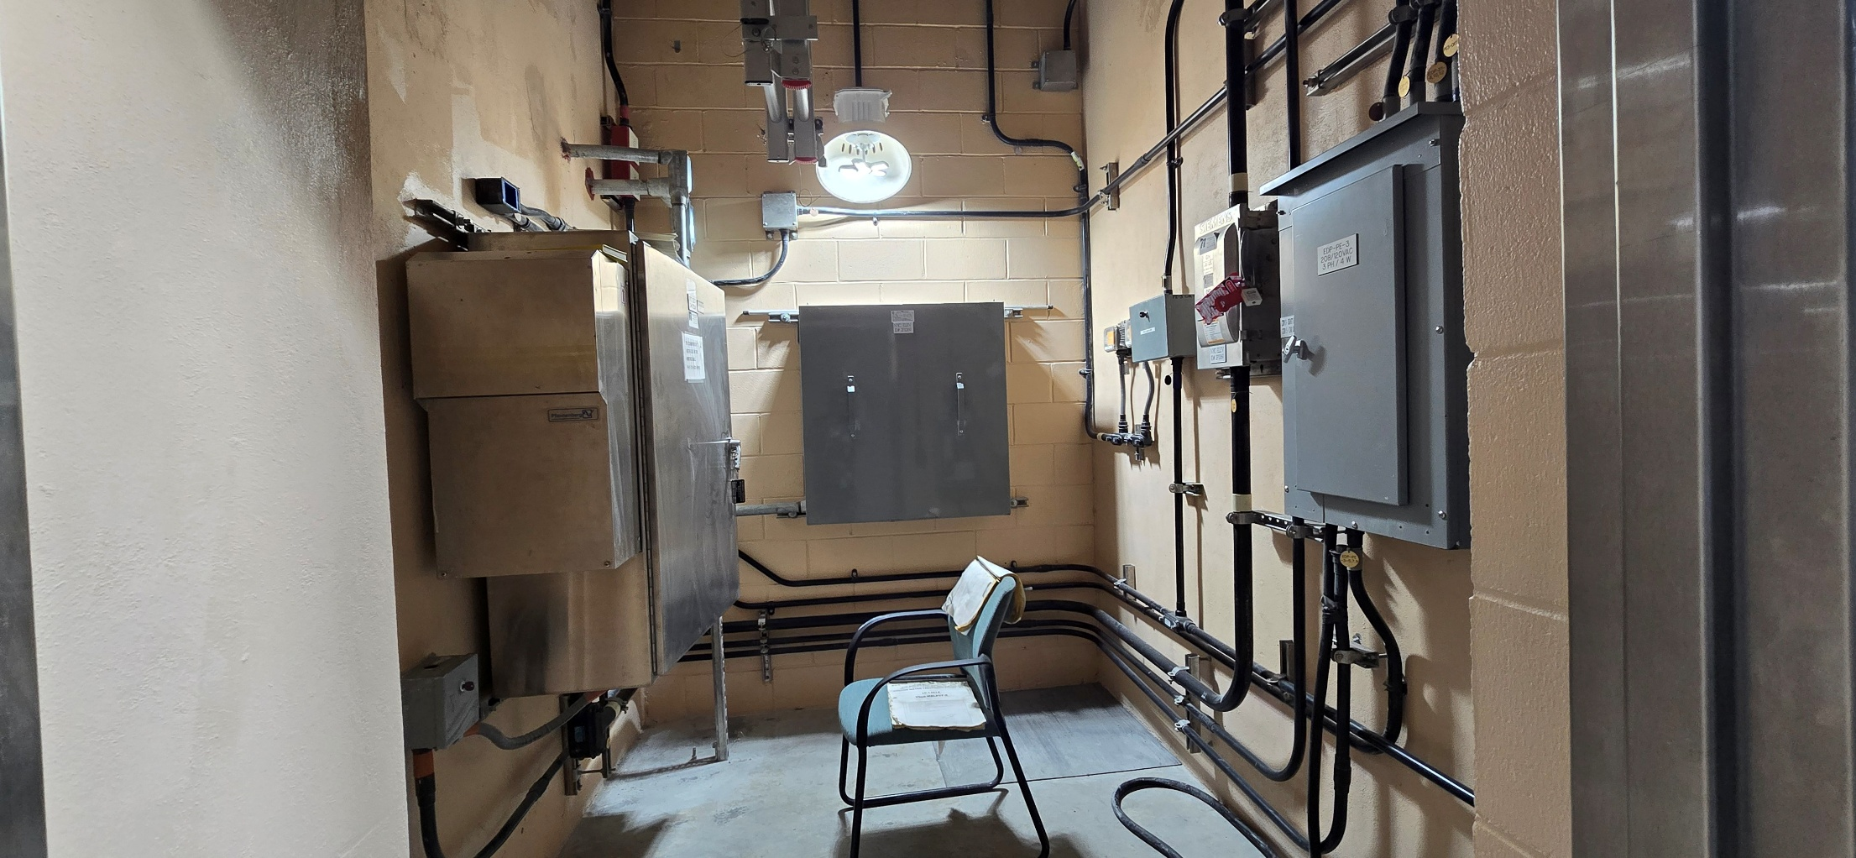
Contract Summary/Scope of Work
Fig. 5 PE-3 Electrical Traction (Passenger) Elevator
Fig. 6 PE-3 Elevator Machine Room

Slide 23
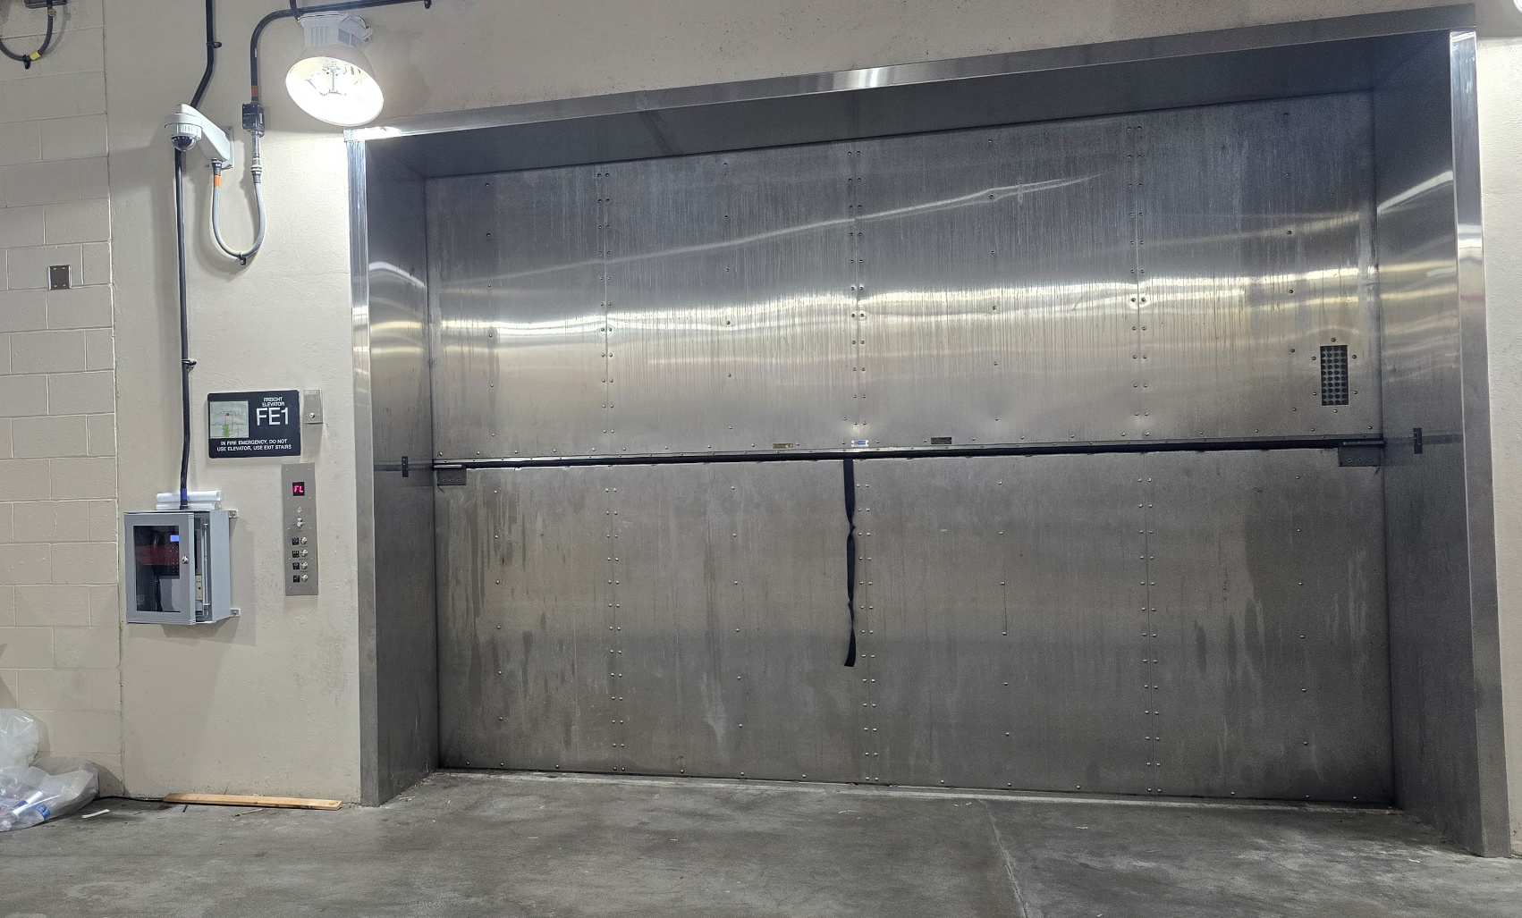
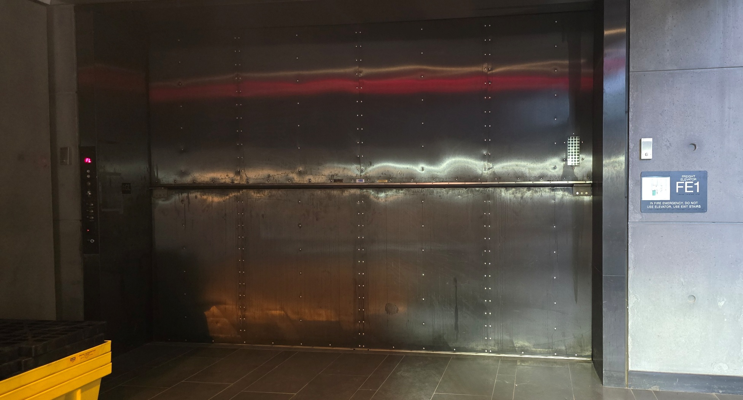
Contract Summary/Scope of Work
Fig. 7 FE-1 Hydraulic (Freight) Elevator at Floor Level FL
Fig. 8 FE-1 Hydraulic (Freight) Elevator at Floor Level GL

Slide 24
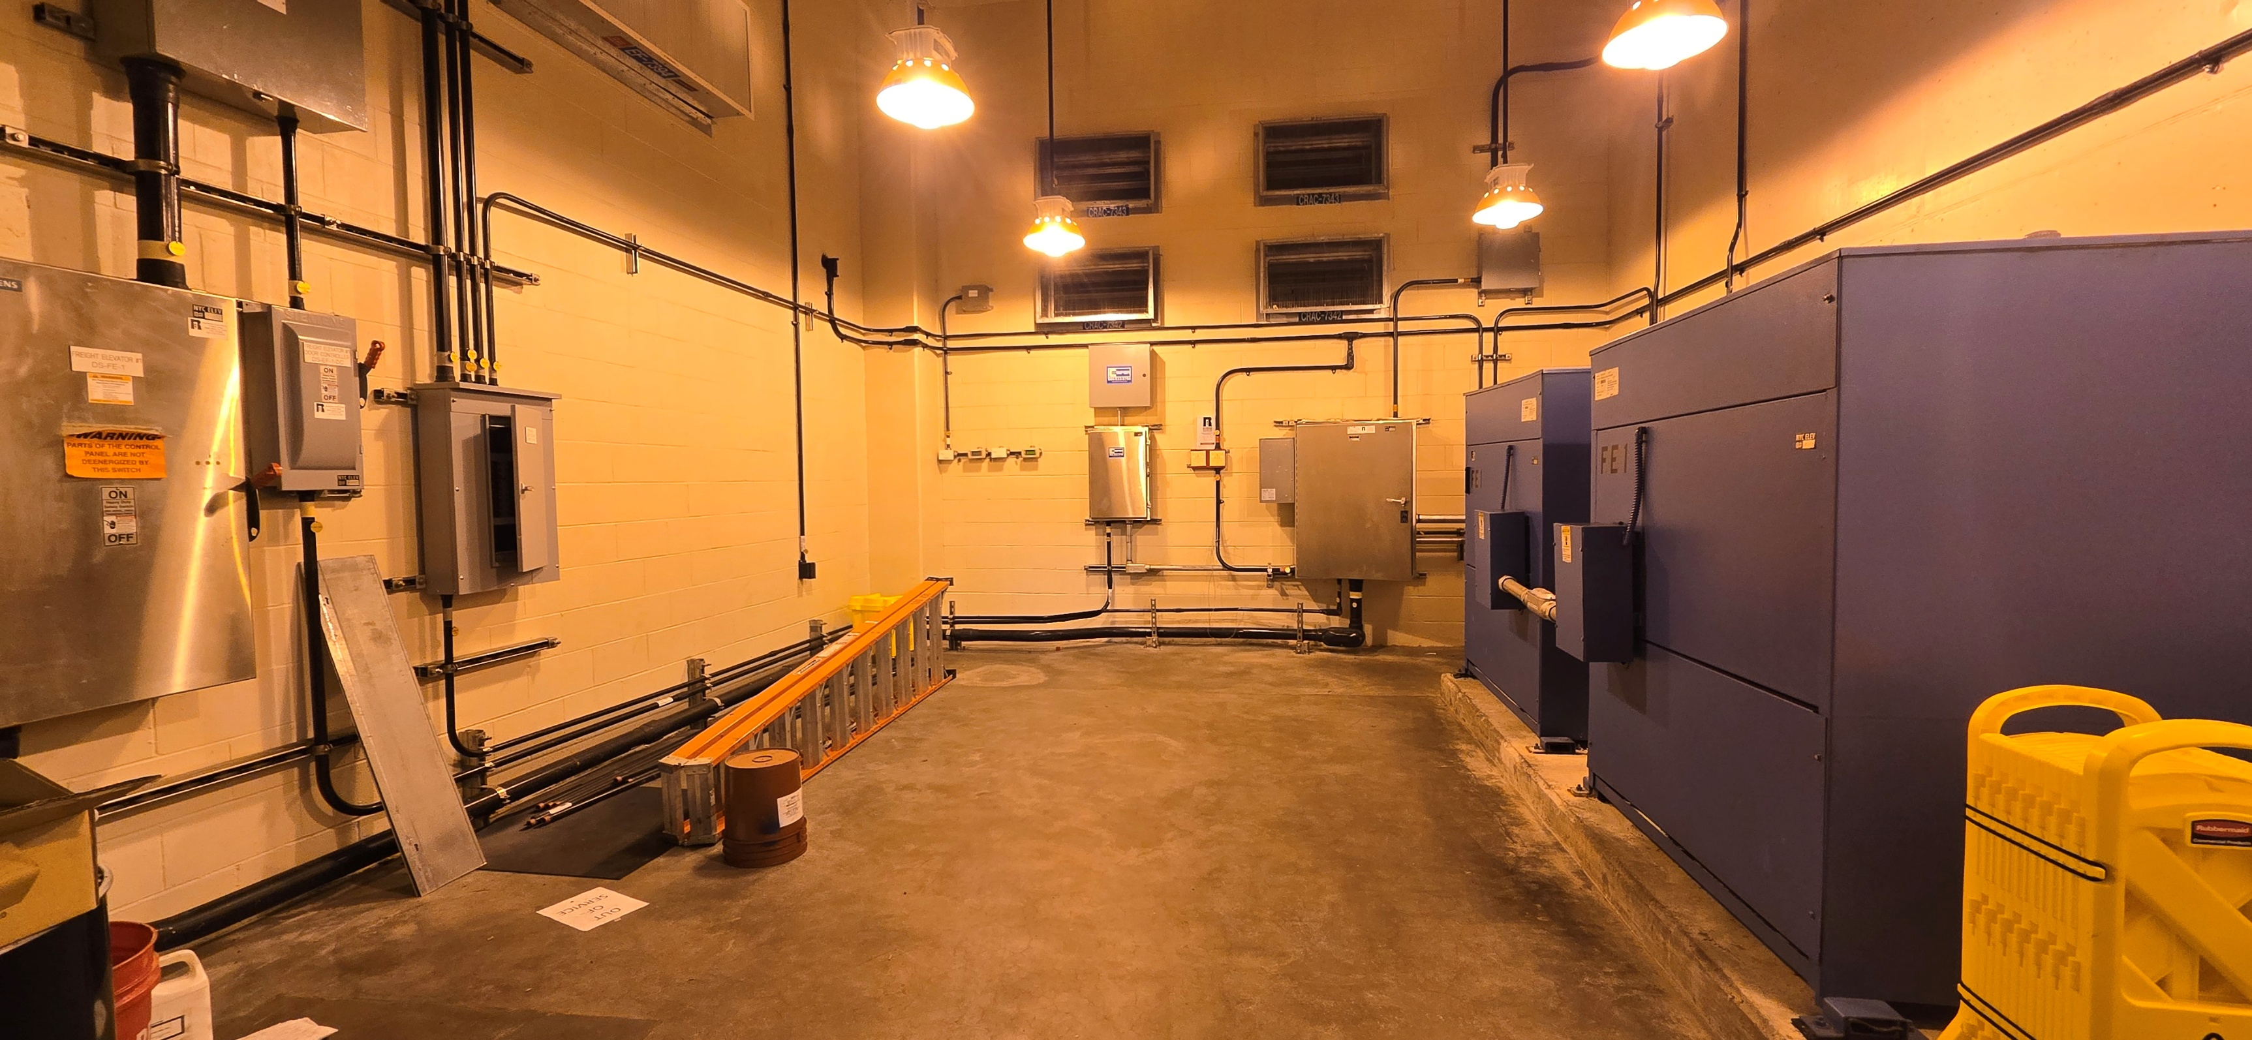
Contract Summary/Scope of Work
Fig. 9 FE-1 Elevator Machine Room

Slide 25
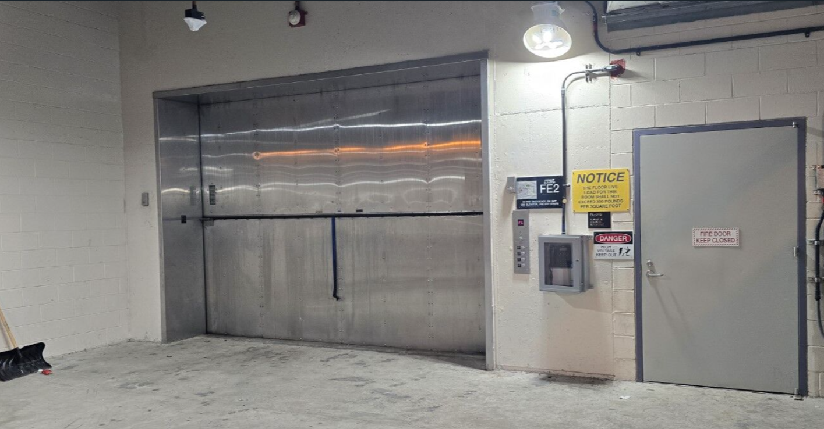
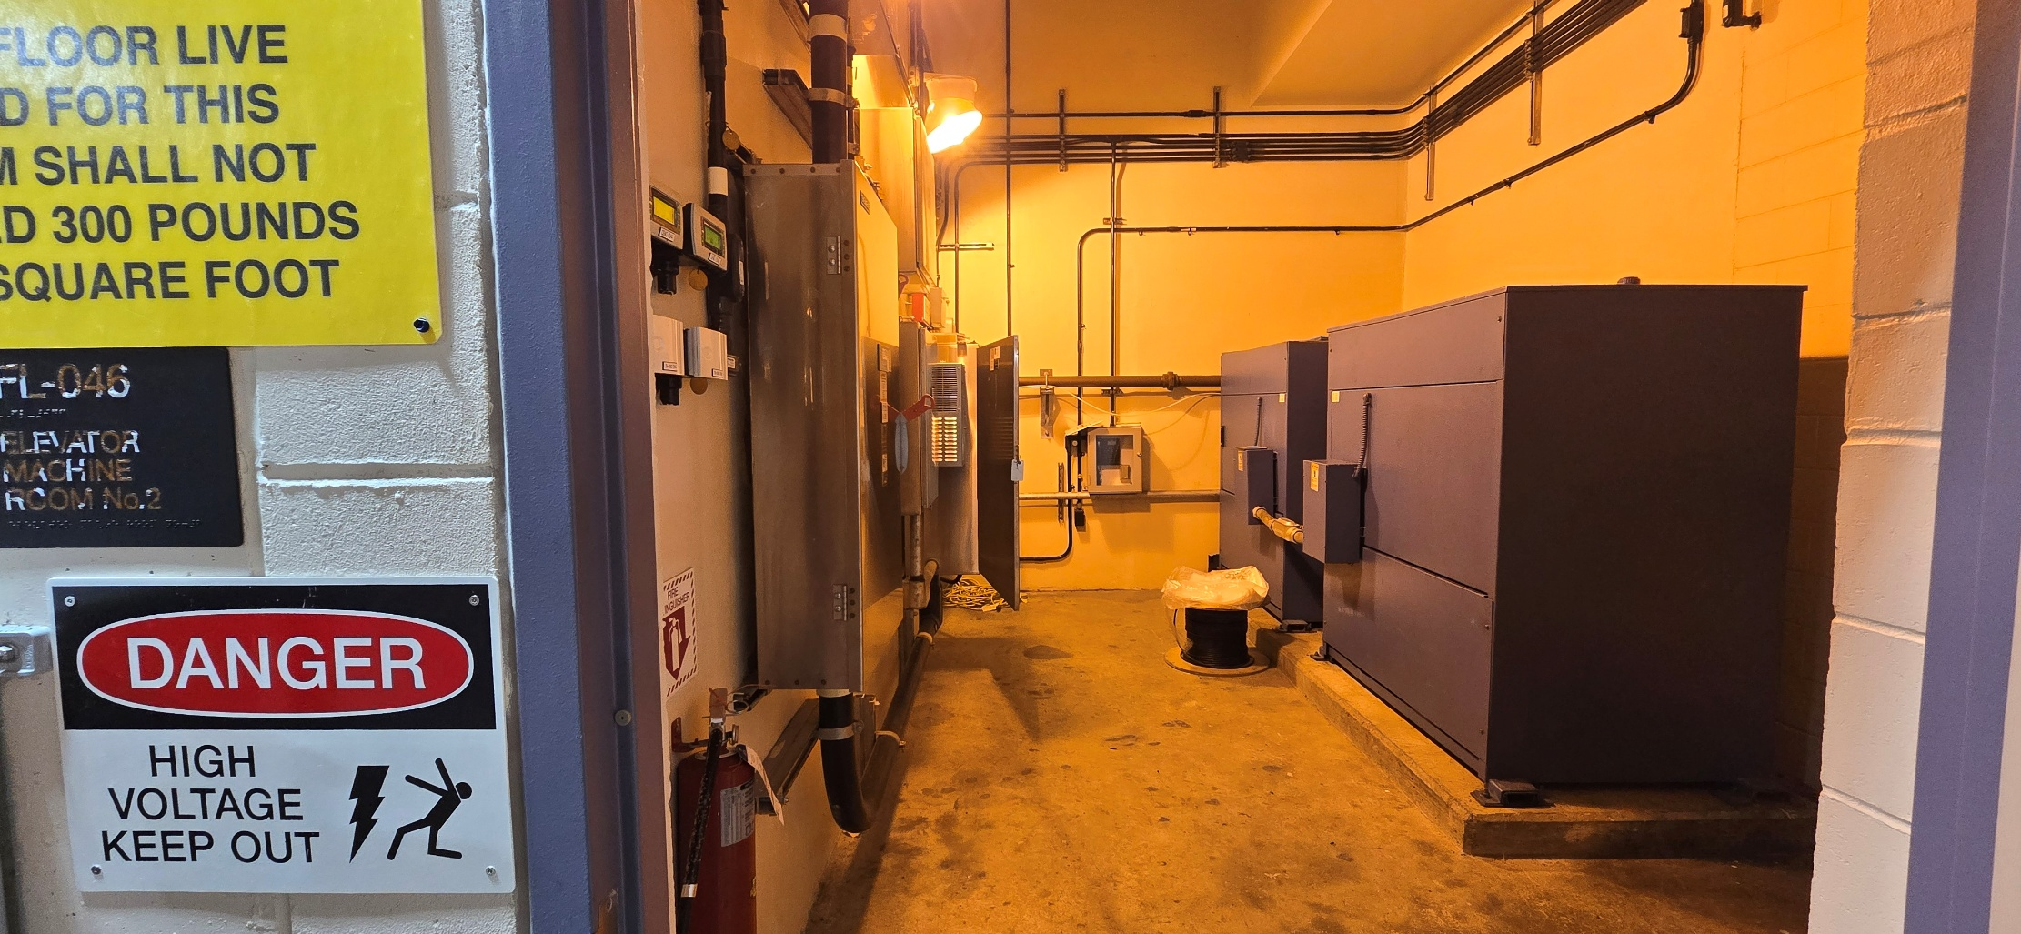
Contract Summary/Scope of Work
Fig. 10 FE-2 Hydraulic (Freight) Elevator Floor Level FL
Fig. 11 FE-2 Elevator Machine Room

Slide 26
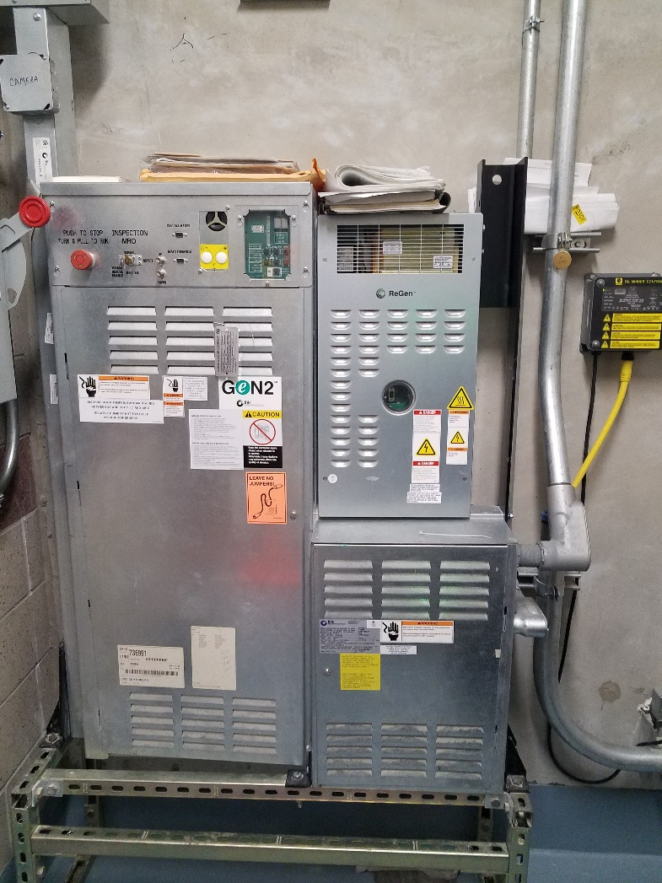
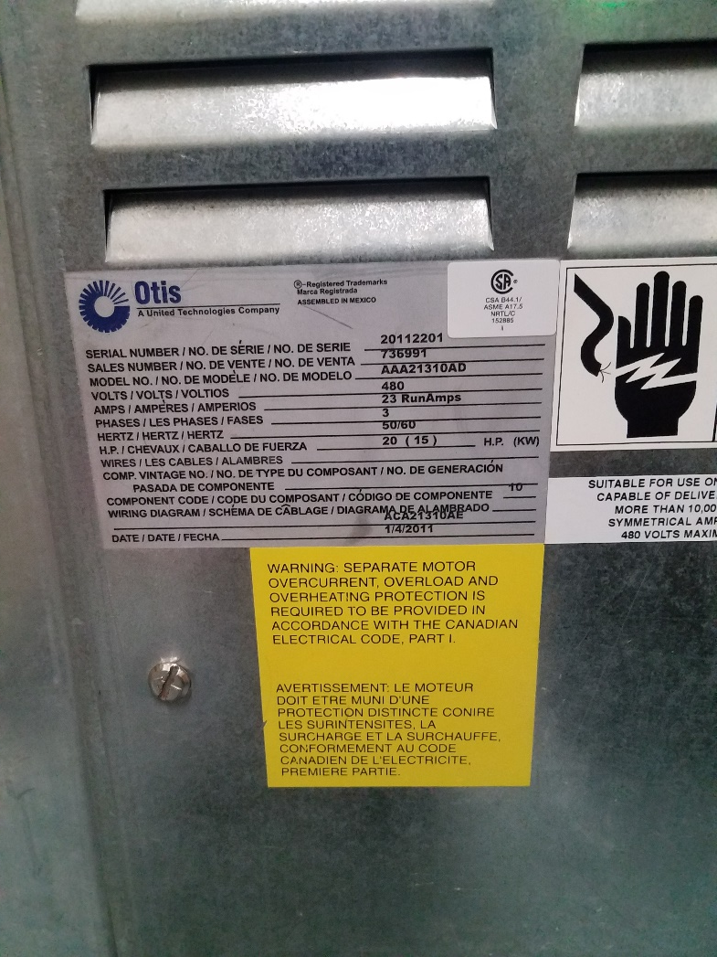
Contract Summary/Scope of Work
Equipment at Catskill/Delaware Ultraviolet Disinfection Plant
Fig. 12 Hydraulic (Freight) Elevator Control
Fig. 13 Otis Name Plate

Slide 27
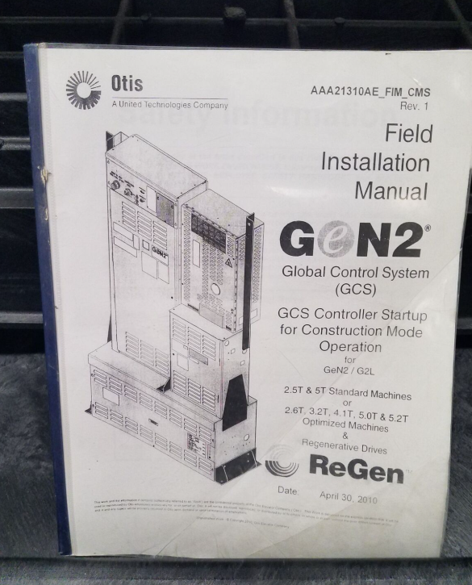
Contract Summary/Scope of Work
Fig. 14 Gen2 Control System Manual

Slide 28
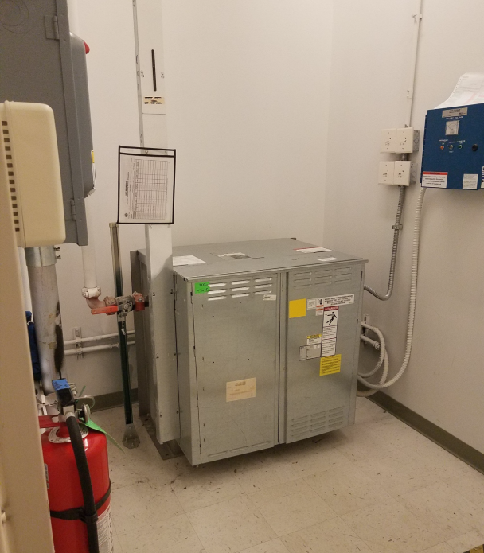
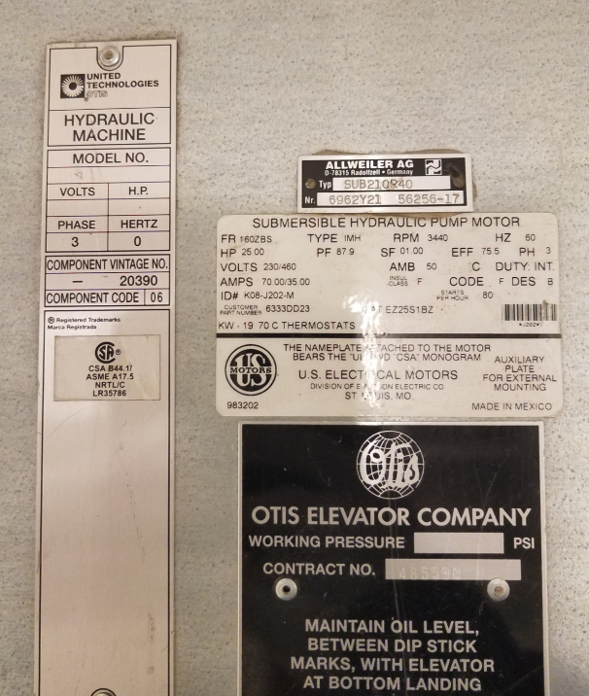
Contract Summary/Scope of Work
Equipment at DEP Police 6th Precinct (Eastview)
Fig. 15 Hydraulic (Passenger) Elevator Machine Room
Fig. 16 Hydraulic (Passenger) Elevator Name Plate

Slide 29
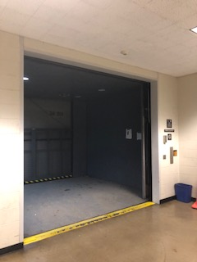
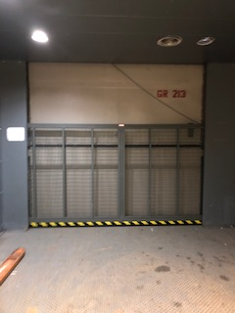
Contract Summary/Scope of Work
Equipment at Croton Lake Gatehouse (CLGH)
Fig. 17 Electrical Traction (Freight) Elevator at Level 213’
Fig. 18 Rear Entrance View Inside Electrical Traction (Freight) Elevator

Slide 30
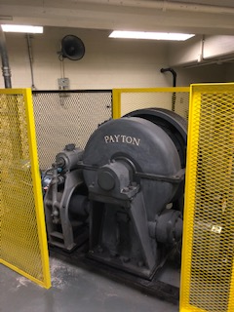
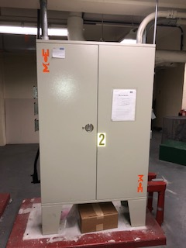
Contract Summary/Scope of Work
Fig. 19 Electrical Traction (Freight) Elevator Drive in Machine Room
Fig. 20 Elevator Controls Inside Machine Room

Slide 31
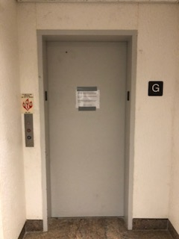
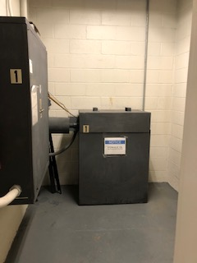
Contract Summary/Scope of Work
Fig. 21 Hydraulic (Passenger) Elevator on the First Floor
Fig. 22 Hydraulic Oil Reservoir in Machine Room

Slide 32
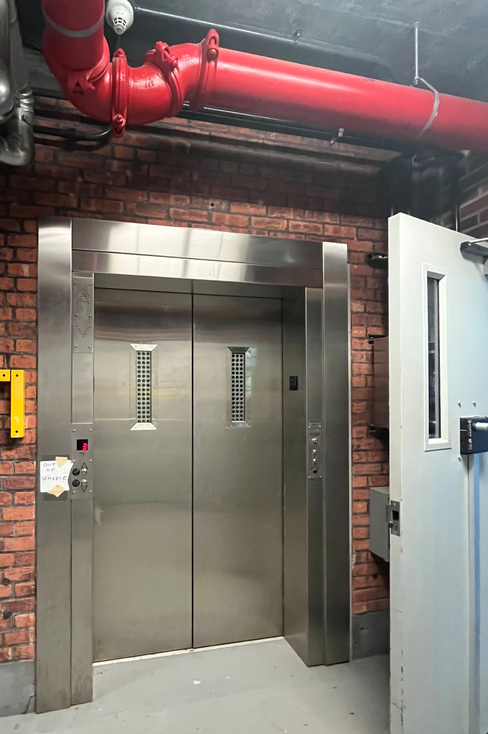
Contract Summary/Scope of Work
Equipment at Delaware Shaft 17
Fig. 23 Rack and Pinion (Freight) Elevator on the First Floor

Slide 33
Health and Safety Requirements
Within 5 business days of DEP request, each requested bidder shall provide the information specified in Exhibit D Standard Environmental, Health & Safety (EHS) Specifications, Section 2 – Pre-Award of the Detailed Specifications. Failure to provide the required information may result in a rejection of the bid.
Required information includes:
  Experience Modification Rating for the last 3 years. If above 1.0, additional information must be provided.
  OSHA 300 Forms and/or 300A worksheets for the last 3 years.
  Sworn, certified and notarized letters on all regulatory violations, notices of deficiencies, and fines issued/received; and reportable releases of chemical or petroleum products
  Written description of firm’s EHS programs
  A sworn, notarized certification from a principal or officer that, if the bidder is awarded the Contract, its EHS programs shall meet all OSHA, USEPA, NYS and local regulations, and the bidder shall abide by applicable DEP policies and procedures

Slide 34

Diversity
Contract Administration
DEP is commitment to valuing diversity and maintaining an inclusive work environment for all New York City employees and its contractors.
It is through the inclusion of our diversity of thought, experience, culture, and background that we do our best work.
New York City’s EEO Policy provides an opportunity for employees and applicants for employment to file discrimination complaints and protects them from retaliation.
The City’s EEO Policy applies to anyone in the workplace. Complaints can be filed against a senior level staff member, a manager, supervisor, or a co-worker. A complaint can also be made about the discriminatory conduct of a person a DEP employee comes in contact with who is not an employee of the Agency, such as a consultant, or vendor.

Slide 35
Diversity
To file a EEO Complaint
NYC DEP EEO Office
5917 Junction Blvd, 20th floor, Flushing NY, 11373
EEOOffice@dep.nyc.gov
New York City Commission on Human Rights
40 Rector Street New York, NY 10006
(212) 306-7500 or (212) 306-7686 (TTD)
United States Equal Employment Opportunity Commission
New York District Office 33 Whitehall Street, 5th Floor New York, NY 10004-2112
(212) 336-2620 or (212) 336-3622 (TTD)
New York State Division of Human Rights
163 West 125th Street, 4th Floor New York, NY 10027
(212) 961-8650 (212) 961-8999 (TTD)
270 Broadway, 9th Floor New York, NY 10007
(212) 417-5041
55 Hanson Place, 3rd Floor Brooklyn, NY 11217
(718) 722-2856
United States Department of Justice
Civil Rights Division Disability Rights Section
New York Avenue Building
950 Pennsylvania Avenue N.W. Washington, DC 20530
(202) 307-0663
Contract Administration
Anyone who feels that they have been discriminated against (including harassment) on the basis on actual or perceived:
Race
Color
national origin
alienage
citizenship status
religion or creed
gender/gender identity
appearance
(behavior or expression, whether or not different from that traditionally associated with the legal sex assigned to the person at birth)
disability
age (18 and over)
military status
prior record of arrest or conviction
marital status
partnership status
genetic information or predisposing genetic characteristic
sexual orientation
status as a victim or witness of domestic violence
sex offenses or stalking
unemployment status

Slide 36
Local Law 1 M/WBE Program Requirements
Local Law 1 (LL-1): New York City M/WBE Program
  The following M/WBE Participation Goals have been established for this contract
  0% Total M/WBE participation requirement
  M/WBE firms must be certified by NYC Small Business Services. A directory of City Certified Firms is available on SBS website at www.nyc.gov/buycertified
  PASSPort will now require information related to the MWBE requirements to be submitted along with the bid/proposal. Additionally, there is a new Schedule B document. The revised Schedule B provides detail about how to enter the required information into PASSPort.
  The Contractor will be required to submit Quarterly M/WBE reports in order to track progress towards meeting the goal

Slide 37
Local Law 1 M/WBE Program Requirements
  The Contractor should also continue good faith efforts to seek opportunities for M/WBE participation during the life of the contract even if proposed M/WBE goals have been achieved
  Note that under the City’s M/WBE Program, suppliers do not count towards a Prime’s M/WBE Utilization
  Prime contractors that do not comply with LL-1 M/WBE goals on this contract are subject to penalties including but not limited to liquidated damages and a poor performance evaluation in PASSPort

Slide 38
SUBCONTRACTOR APPROVAL
  All subcontractors must be approved by DEP prior to the start of subcontractors commencing work.
    Subcontractor Approval requests are submitted in PASSPort, the physical Subcontractor Approval Form (SAF) is no longer required. Subcontractor approval is required for all subcontractors regardless of tier. Subcontractors cannot start work without any approval.
A subcontractor approval is not needed for a supplier that strictly delivers equipment, goods or materials and leaves the project site after the delivery is made. For the purposes of ACCO subcontractor approval, a vendor is not considered a supplier if in addition to providing equipment, goods or materials, it also provides other services on or off site to the project including but not limited to installation, maintenance or consulting services
Subcontractor approval is required for every new subcontract and on contract renewals

Slide 39
PREVAILING WAGE
This contract is subject to prevailing wage requirements under Article 8 from Comptroller Determination of the NYS Labor Law.
Workers must be paid the prevailing wage and supplement rates that are in effect (for each trade) at the time the work is performed.
Work is located in Bronx and Westchester Counties. The prevailing wage rate to be paid is related to the county where the Work is being performed.
NYC Comptroller’s current certified payroll report forms (last updated September 2019) and DEP employee sign in sheets are required for all trade work performed under this contract.
The prevailing wage titles anticipated under this Contract include, but are not necessarily limited to: Elevator Service/Modernization Mechanic (NYC), Elevator Constructor- Modernization & Service Repair (Westchester), Elevator Constructor – Mechanic (Westchester – Yorktown), Electrician M (NYC, Westchester), Fire Watcher(NYC, Westchester).
To view the most recent Schedules, click on the link below
  NYC Comptroller Prevailing Wage Schedules or Public Work and Prevailing Wage (ny.gov)

Slide 40
PASSPort
All Bids/Proposals/Questions must be submitted in PASSPort
For assistance in using PASSPort contact the MOCS at:
MOCS Service Desk

Slide 41
PASSPort Discussion Forum Tab
The Discussion with buyer tab is a forum to communicate directly in PASSPort with the RFx contracting agency after you have decided to respond to the RFx (i.e. clicked “Participate in RFx” button).
PASSPort maintains and can display a record of all interactions between you and the agency.
Indicate the Type of message you would like to send by selecting a category from the drop-down.
Add a Subject line.
Indicate the agency contact to whom you are sending this message by selecting from the drop-down menu.
Compose your message in the textbox.
Click the “Send” button to submit your message

Slide 42
PASSPort Helpful Links
PASSPort User Materials - MOCS (nyc.gov)
Vendor Enrollment Video
Vendor Account Management PDF
E-Course Responding to Contracting Opportunities(RFx)
E-Course Contract Registration for Vendors

Slide 43
Registration with State Department of Labor
New Requirement Effective December 30, 2024
- Pursuant to Labor Law 220-i, Contractors must be registered with the New York State Department of Labor Contractor and Subcontractor Registry prior to submitting bids/proposals on public works projects covered by Article 8 of the
Labor Law.
https://dol.ny.gov/public-work-contractor-and-subcontractor-registry-landing
- Vendors should submit their NYSDOL certificate within PASSPort as part of their bid response (under the required documents section).
  Note that failure to provide this certification may be grounds for being found non-responsive.

Slide 44
General Contract Requirements
Contract Term is 1095 ccds (3 years) from DEP’s Notice to Proceed with one (1), two (2) year renewal option.
The Work under this Contract is subject to prevailing wages, as defined in the Labor Law Section 220 and/or 230.
All workers must be paid by check or direct deposit.
Be sure to review Schedule A in the Bid Booklet for contract and insurance requirements.
Maximum overall subcontracting on contract cannot exceed 40%.

Slide 45
BID PROTOCOL/KEY DATES
Request for Information (RFI) can be submitted only electronically through the City of New York PASSPort system.
Questions During RFI:
  PASSPort system, Discussion Forum, is the point of contact for vendor questions
  Discussion Forum will be used to provide answers to questions
  Responses to information requests by phone will not be provided.
  Question Deadline is March 26, 2026
Response Due Date is April 21, 2026 at 10:00 AM
Response Opening Date is April 21, 2026 at 2:00 PM via Microsoft Teams

Slide 46

Questions

